Slide 1
IT628: Systems Programming
Course outline, process creation

Slide 2
What’s this course all about?
Operating systems provide a set of constructs and well-defined primitives to simplify application development
You will learn how to write applications that exploit important OS features
Often we will present an OS concept first and then the system calls associated with that concept

Slide 3
Main topics we’ll cover
  Concurrent programming
    processes, signals, pipes, threads, synchronization
  Network programming
    sockets and servers

Slide 4
System calls
A request for the OS to do something on behalf of the user’s program
Example
  fork() /* create a child process */
  exec() /* executing a program */
Don’t confuse system calls with libc calls
  strcpy()

Slide 5
Main categories of system calls
File system
  Low-level file I/O
  E.g., creat, open, read, write, lseek, close
Multi-tasking mechanisms
  Process control
  E.g., fork, wait, exec, exit, signal, kill
Inter-process communication
  E.g., pipe, dup, dup2

Slide 6
Classroom organization
Standard lecture format with exercises sprinkled in for class discussion
We’ll also demo code examples in class
Questions are ALWAYS encouraged (both directions)

Slide 7
Classroom Etiquette
Come on time to both class and labs
Talking, cell phones, etc. will not be tolerated

Slide 8
Reference books
Keith Haviland, Dina Gray and Ben Salama
  “UNIX System Programming”, Addison-Wesley
Randal Bryant and David O’Hallaron
  “Computer Systems: A Programmer’s Perspective”, Pearson India
Brian Kernighan and Dennis Ritchie
  “The C Programming Language, Second Edition”, Prentice Hall India

Slide 9
Grade breakdown
Exams (70%): two insem exams and final
  two insems weighted 20%
  final weighted 50% (covers entire course)
Lab exercises (checkoffs) and homework (30%)
  weighted 20%, 10%
  lab attendance is mandatory

Slide 10
Processes
A process is the basic unit of execution in an OS
A process is a running instance of a program
  Program = static file (image)
  Process = executing program = program + execution state
Two processes are said to run concurrently when instructions of one process are interleaved with the instructions of the other process

Slide 11
Context switching
Transferring control from the current process to another process is called a context switch
  OS saves the state of the current process, restores the state of the other process, and passes control to the new process
From a human observer’s point of view, many processes appear to proceed simultaneously

Slide 12
fork()
fork creates a new process
the process created (child) runs the same program as the creating (parent) process
  and starts with the same PC,
  the same CPU registers,
  the same open files, etc.

Slide 13
Pparent
int main(){
fork();
foo();
}
OS

Slide 14
Pparent
int main(){
fork();
foo();
}
OS

Slide 15
Pparent
Pchild
int main(){
fork();
foo();
}
int main(){
fork();
foo();
}
OS
creates

Slide 16
Pparent
Pchild
int main(){
fork();
foo();
}
int main(){
fork();
foo();
}
OS

Slide 17
fork(), when called, returns twice
(to each process @ the next instruction)
int main() {
fork();
printf(“Hello world!\n”);
}
Hello world!
Hello world!

Slide 18

int main() {
fork();
fork();
printf(“Hello world!\n”);
}
Hello world!
Hello world!
Hello world!
Hello world!

Slide 19
int main() {
fork();
fork();
fork();
printf(“Hello world!\n”);
}
Hello world!
Hello world!
Hello world!
Hello world!
Hello world!
Hello world!
Hello world!
Hello world!

Slide 20
return value of fork()
typedef int pid_t;
pid_t fork();
system-wide unique process identifier
child’s pid (> 0) is returned in the parent
sentinel value (0) is returned in the child

Slide 21
void fork0() {
if (fork()==0)
printf(“Hello from Child!\n”);
else
printf(“Hello from Parent!\n”);
}
main(){ fork0(); }
Hello from Child!
Hello from Parent!
(or)
Hello from Parent!
Hello from Child!

Slide 22
void fork3() {
int i;
sum = 0;
fork(); /* create a new process */
for (i=1 ; i<=5 ; i++) {
printf ("The value of i is %d\n", i);
fflush(stdout);
sum += i;
}
printf ("The sum is %d\n", sum);
exit(0)
}
main(){ fork3(); }

Slide 23
order of execution is non-deterministic
  parent and child run concurrently
Important: post fork, parent and child are identical but separate!
  OS allocates and maintains separate data/state
  control flow can diverge

Slide 24
void fork1() {
int x = 1;
if (fork()==0){
printf(“Child has x = %d\n”, ++x);
} else {
printf(“Parent has x = %d\n”, --x);
}
}
Parent has x = 0
Child has x = 2

Slide 25
Summary
process != program
Process: dynamic execution context of an executing program
Several processes may run the same program code, but each is a distinct process with its own state
Read http://stackoverflow.com/questions/985051/what-is-the-purpose-of-fork

Slide 26
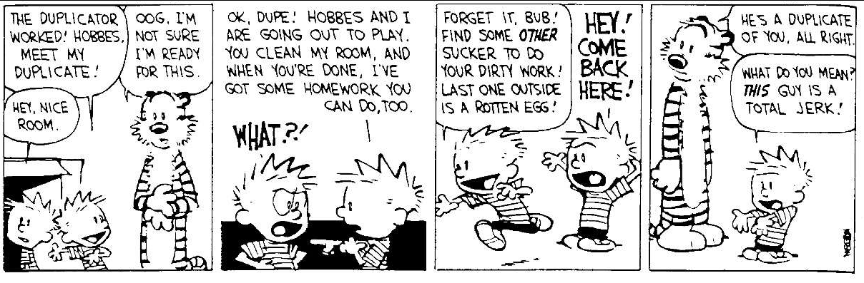
Humor

Slide 27
fork practice problems

Slide 28
void fork2() {
printf(“L0\n”);
fork();
printf(“L1\n”);
fork();
printf(“Bye\n”);
}
L0
L1
L1
Bye
Bye
Bye
Bye

Slide 29
process graph:
void fork2() {
printf(“L0\n”);
fork();
printf(“L1\n”);
fork();
printf(“Bye\n”);
}
Bye
L1
Bye
Bye
L0
L1
Bye

Slide 30
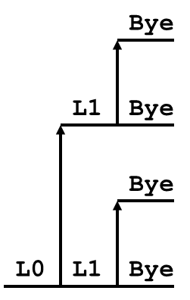
void fork2() {
printf(“L0\n”);
fork();
printf(“L1\n”);
fork();
printf(“Bye\n”);
}
Which are possible?
A. B. C. D. E.
L1
L0
L1
Bye
Bye
Bye
Bye
L0
L1
Bye
Bye
L1
Bye
Bye
L0
L1
Bye
Bye
Bye
L1
Bye
L1
Bye
Bye
L0
L1
Bye
Bye
L0
Bye
Bye
L1
L1
Bye
Bye

Slide 31
void fork3() {
printf(“L0\n”);
fork();
printf(“L1\n”);
fork();
printf(“L2\n”);
fork();
printf(“Bye\n”);
}
Which are possible?
Bye
L2
Bye
Bye
L1
L2
Bye
Bye
L2
Bye
Bye
L0
L1
L2
Bye

Slide 32
void fork4() {
printf(“L0\n”);
if (fork()!= 0) {
printf(“L1\n”);
if (fork()!= 0) {
printf(“L2\n”);
fork();
}
}
printf(“Bye\n”);
}
A. B. C. D. E.
L0
L1
L2
Bye
Bye
Bye
Bye
L0
L1
Bye
Bye
L2
Bye
Bye
Bye
L0
Bye
L1
Bye
L2
Bye
L0
Bye
L1
Bye
L2
Bye
Bye
L0
L1
Bye
Bye
Bye
L2
Bye

Slide 33
void fork4() {
printf(“L0\n”);
if (fork()!= 0) {
printf(“L1\n”);
if (fork()!= 0) {
printf(“L2\n”);
fork();
}
}
printf(“Bye\n”);
}
Bye
Bye
Bye
L0
L1
L2
Bye

Slide 34
void fork5() {
printf(“L0\n”);
if (fork()== 0) {
printf(“L1\n”);
if (fork()== 0) {
printf(“L2\n”);
fork();
}
}
printf(“Bye\n”);
}
Bye
L2
Bye
L1
Bye
L0
Bye

